Slide 1
Agile Modeling and Prototyping
6
Kendall & Kendall Systems Analysis and Design, 9e
Notes:
1

Slide 2
Learning Objectives
Understand the roots of agile modeling in prototyping and the four main types of prototyping.
Be able to use prototyping for human information requirements gathering.
Understand agile modeling and the core practices that differentiate it from other development methodologies.
Learn the importance of values critical to agile modeling.
Understand how to improve efficiency for users who are knowledge workers using either structured methods or agile modeling.

Slide 3
Agile Modeling, but First Prototyping
Agile modeling is a collection of innovative, user-centered approaches to system development
Prototyping is an information-gathering technique useful in seeking
User reactions
Suggestions
Innovations
Revision plans
Notes:
Prototyping and RAD (rapid application development) can also be used as an alternative method to SDLC.

Slide 4
Major Topics
Prototyping
Agile modeling

Slide 5
Prototyping
Patched-up
Nonoperational
First-of-a-series
Selected features
Notes:
Information gathered in the prototyping phase allows the analyst to set priorities and redirect plans inexpensively, with a minimum of disruption.

Slide 6
Patched-Up Prototype
A system that works but is patched up or patched together
A working model that has all the features but is inefficient
Users can interact with the system
Retrieval and storage of information may be inefficient
Notes:
In engineering this approach is referred to as breadboarding.
Users can interact with the system—getting accustomed to the interface and types of output available.
Retrieval and storage of information may be inefficient—programs were written rapidly with the objective of being workable rather than efficient.

Slide 7
Nonoperational Scale Models
A nonworking scale mode that is set up to test certain aspects of the design
A nonworking scale model of an information system might be produced when the coding required by the application is too expensive to prototype but when a useful idea of the system can be gained through prototyping of the input and output only.
Notes:
A nonworking scale model of an information system:
processing because of undue cost and time, would not be prototyped.
users can make decisions based on their use of prototyped input and output.

Slide 8
First-of-a-Series Prototype
Creating a pilot
Prototype is completely operational
Useful when many installations of the same information system are planned
A full-scale prototype is installed in one or two locations first, and if successful, duplicates are installed at all locations based on customer usage patterns and other key factors
Notes:
Pilot —a first full-scale model of a system.
Creation of a working model is one of the types of prototyping done with RAD.

Slide 9
Selected Features Prototype
Building an operational model that includes some, but not all, of the features that the final system will have
Some, but not all, essential features are included
Built in modules
Part of the actual system
Notes:
Some, but not all, essential features are included—a menu on a screen that lists six features may only have three available.
Built in modules—if the features that are prototyped are evaluated by users as successful, they can be incorporated into the larger, final system without undertaking immense work in interfacing.
Part of the actual system—not just a mock-up.

Slide 10
Four Kinds of Prototypes Clockwise, Starting from the Upper Left (Figure 6.1)

Slide 11
Prototyping as an Alternative to the Systems Life Cycle
Two main problems with the SDLC
Extended time required to go through the development life cycle
User requirements change over time
Rather than using prototyping to replace the SDLC use prototyping as a part of the SDLC
Notes:
SDLC—a logical, systematic approach to follow in the development of information systems.
Rather than using prototyping to replace the SDLC use prototyping as a part of the SDLC.
Advantages:
effectively shortens the time between ascertainment of human information requirements and delivery of a workable system.
overcomes some of the problems of accurately identifying user information requirements.
Disadvantages:
prematurely shaping a system before the problem or opportunity being addressed is thoroughly understood.
may result in producing a system that is accepted by specific groups of users but that is inadequate for overall system needs.

Slide 12
Drawbacks to Supplanting the SDLC With Prototyping
Drawbacks include prematurely shaping a system before the problem or opportunity is thoroughly understood
Using prototyping as an alternative may result in producing a system that is accepted by specific groups of users but is inadequate for overall system needs

Slide 13
Guidelines for Developing a Prototype
Work in manageable modules
Build the prototype rapidly
Modify the prototype in successive iterations
Stress the user interface
Notes:
Prototyping is a superb way to elicit feedback about the proposed system and about how readily it is fulfilling the information needs of its users.
The first step of prototyping is to estimate the costs involved in building a module of the system.
Work in manageable modules—a manageable module is one that allows users to interact with its key features but can be built separately from other system modules.
Build the prototype rapidly—putting together an operational prototype both rapidly and early in the SDLC allows the analyst to gain valuable insight into how the remainder of the project should go.
Modify the prototype—creating it in modules that are not highly interdependent.
Stress the user interface—for many users the interface is the system.

Slide 14
Work in Manageable Modules
It is imperative that an analyst work in manageable modules
One distinct advantage of prototyping is that it is not necessary or desirable to build an entire working system for prototype purposes
A manageable module allows users to interact with its key features but can be built separately from other system modules
Module features that are deemed less important are purposely left out of the initial prototype

Slide 15
Build the Prototype Rapidly
Speed is essential for successful prototyping
Analysts can use prototyping to shorten this gap by using traditional information-gathering techniques to find information requirements
Make decisions that bring forth a working model
Putting together an operational prototype rapidly and early in the SDLC allows an analyst to gain insight about the remainder of the project
Showing users early in the process how parts of the system actually perform guards against overcommitting resources to a project that may eventually become unworkable

Slide 16
Modify the Prototype in successive iterations
Making a prototype modifiable means creating it in modules that are not highly interdependent
The prototype is usually modified several times
Changes should move the system closer to what users say is important
Each modification is followed by an evaluation by users

Slide 17
Stress the User Interface
Use the prototype is to get users to further articulate their information requirements
They should be able to see how the prototype will enable them to accomplish their tasks
The user interface must be well developed enough to enable users to pick up the system quickly
Online, interactive systems using GUI interfaces are ideally suited to prototypes

Slide 18
Disadvantages of Prototyping
It can be difficult to manage prototyping as a project in the larger systems effort
Users and analysts may adopt a prototype as a completed system
Notes:
Users and analysts may adopt a prototype as a completed system—when it is in fact inadequate and was never intended to serve as a finished system.

Slide 19
Advantages of Prototyping
Potential for changing the system early in its development
Opportunity to stop development on a system that is not working
Possibility of developing a system that more closely addresses users’ needs and expectations
Notes:
Successful prototyping depends on early and frequent user feedback, which analysts can use to modify the system and make it more responsive to actual needs.

Slide 20
Prototyping Using COTS Software
Sometimes the quickest way to prototype is through the modular installation of COTS software
Some COTS software is elaborate and expensive, but highly useful
Notes:
Example: Catholic University’s use of the ERP COTS software package called PeopleSoft, which is handling many of its web-based functions.

Slide 21
Users’ Role in Prototyping
Honest involvement
Experimenting with the prototype
Giving open reactions to the prototype
Suggesting additions to or deletions from the prototype
Notes:
Without user involvement there is little reason to prototype.
To facilitate the prototyping process, the analyst must clearly communicate the purposes of prototyping to users, along with the idea that prototyping is valuable only when users are meaningfully involved.

Slide 22
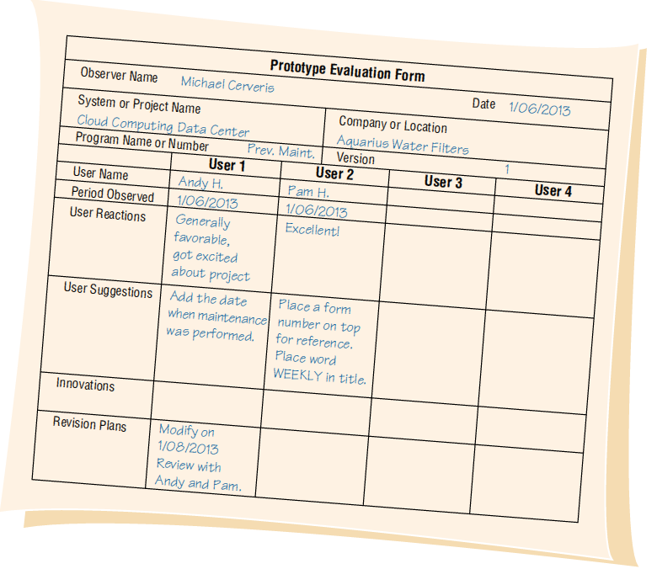
Prototype Evaluation Form (Figure 6.3)

Slide 23
Agile Modeling
Agile methods are a collection of innovative, user-centered approaches to systems development

Slide 24
Values and Principles of Agile Modeling
Communication
Simplicity
Feedback
Courage
Notes:
Agile modelers possess the self-confidence to allow their customers to question, critique, and sometimes complain about the system under development. Analysts learn from their customers, who have been in business a long time.

Slide 25
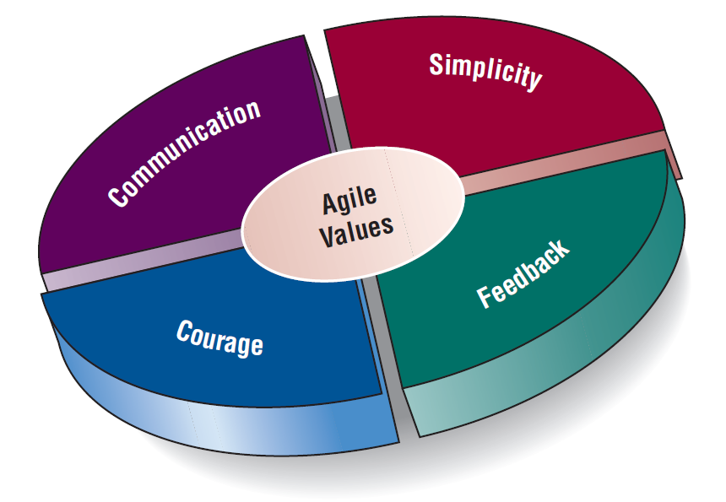
Values Are Crucial to the Agile Approach (Figure 6.4)

Slide 26
The Basic Principles of Agile Modeling
Satisfy the customer through delivery of working software
Embrace change, even if introduced late in development
Continue to deliver functioning software incrementally and frequently
Encourage customers and analysts to work together daily
Trust motivated individuals to get the job done
Notes:
Providing rapid feedback—in order for humans or the system to make a connection between a stimulus and reaction, the feedback must occur at a reasonable interval.
Assuming simplicity—over 90 percent of problems can be solved with utter simplicity.
Changing incrementally—you are constantly making the smallest change possible that still results in a difference in the development effort.
Embracing change—we want to keep all of our options open, but we want to be able to simultaneously solve whatever presents the biggest obstacle.
Encouraging quality work—all participants want to do quality work.

Slide 27
The Basic Principles of Agile Modeling (continued)
Promote face-to-face conversation
Concentrate on getting software to work
Encourage continuous, regular, and sustainable development
Adopt agility with attention to mindful design
Support self-organizing teams
Notes:
Providing rapid feedback—in order for humans or the system to make a connection between a stimulus and reaction, the feedback must occur at a reasonable interval.
Assuming simplicity—over 90 percent of problems can be solved with utter simplicity.
Changing incrementally—you are constantly making the smallest change possible that still results in a difference in the development effort.
Embracing change—we want to keep all of our options open, but we want to be able to simultaneously solve whatever presents the biggest obstacle.
Encouraging quality work—all participants want to do quality work.

Slide 28
The Basic Principles of Agile Modeling (continued)
Provide rapid feedback
Encourage quality
Review and adjust behavior occasionally
Adopt simplicity
Notes:
Providing rapid feedback—in order for humans or the system to make a connection between a stimulus and reaction, the feedback must occur at a reasonable interval.
Assuming simplicity—over 90 percent of problems can be solved with utter simplicity.
Changing incrementally—you are constantly making the smallest change possible that still results in a difference in the development effort.
Embracing change—we want to keep all of our options open, but we want to be able to simultaneously solve whatever presents the biggest obstacle.
Encouraging quality work—all participants want to do quality work.

Slide 29
Four Basic Activities of Agile Modeling
Coding
Testing
Listening
Designing
Notes:
The agile analyst needs to identify the amount of effort that will go into each activity and balance that with the resources needed to complete the project.
Coding—the most valuable thing that we receive from code is “learning.”
Testing—the agile approach views automated tests as critical.
Listening—in the agile approach, listening is done in the extreme.
Designing—a way of creating a structure to organize all of the logic in the system.

Slide 30
Coding
Coding is the one activity that it is not possible to do without
The most valuable thing that we receive from code is “learning”
Code can also be used to communicate ideas that would otherwise remain fuzzy or unshaped

Slide 31
Testing
Automated testing is critical
Write tests to check coding, functionality, performance, and conformance
Use automated tests
Large libraries of tests exist for most programming languages
These are updated as necessary during the project
Testing in the short term gives extreme confidence in what you are building
Testing in the long term keeps a system alive and allows for changes longer than would be possible if no tests were written or run

Slide 32
Listening
Listening is done in the extreme
Developers use active listening to hear their programming partner
Because there is less reliance on formal, written communication, listening becomes a paramount skill
A developer also uses active listening with the customer
Developers assume that they know nothing about the business so they must listen carefully to businesspeople

Slide 33
Designing
Designing is a way of creating a structure to organize all the logic in the system
Designing is evolutionary, and so systems are conceptualized as evolving, always being designed
Good design is often simple
Design should allow flexibility
Effective design locates logic near the data on which it will be operating
Design should be useful to all those who will need it as the development effort proceeds

Slide 34
Four Resource Control Variables of Agile Modeling
Time
Cost
Quality
Scope
Notes:
When these four control variables are properly included in the planning, there is a state of balance between the resources and the activities needed to complete the project.

Slide 35
Four Core Agile Practices
Short releases
40-hour work week
Onsite customer
Pair programming
Notes:
Short releases—the development team compresses the time between releases of their product.
40-hour work week—agile development teams purposely endorse a cultural core practice in which the team works intensely together during a typical 40-hour work week.
Onsite customer—a user who is an expert in the business aspect of the systems development work is onsite during the development process.
Pair programming—you work with another programmer of your own choosing.

Slide 36
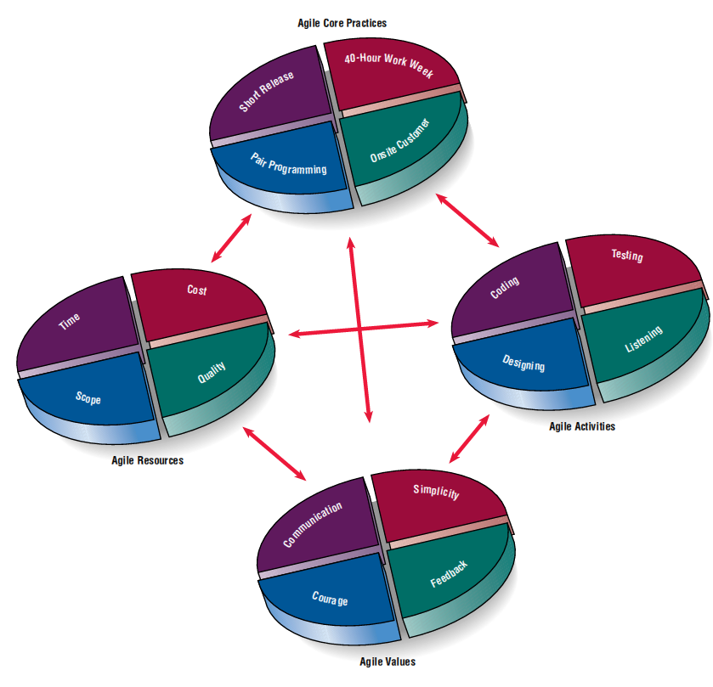
Agile Core Practices (Figure 6.5)

Slide 37
The Agile Development Process
Listen for user stories
Draw a logical workflow model
Create new user stories based on the logical model
Develop some display prototypes
Create a physical data model using feedback from the prototypes and logical workflow diagrams

Slide 38
Writing User Stories
Spoken interaction between developers and users
Seeking first and foremost to identify valuable business user requirements
The goal is prevention of misunderstandings or misinterpretations of user requirements
Notes:
User stories serve as reminders to the developers that they must hold conversations devoted to those requirements.

Slide 39
User Stories Can Be Recorded on Cards (Figure 6.6)
Notes:
In this example from the online merchant, the analyst indicates that the designing activity will take above-average effort, and the time and quality resources are required to rise above average.

Slide 40
Scrum
Begin the project with a high-level plan that can be changed on the fly
Success of the project is most important
Individual success is secondary
Project leader has some (not much) influence on the detail
Systems team works within a strict time frame

Slide 41
Scrum
Product backlog
Sprint backlog
Sprint
Daily scrum
Demo
Notes:
Scrum is a high-intensity methodology. It is just one of the approaches that adopts the philosophy of agile modeling.
Product backlog—in which a list is derived from product specifications.
Sprint backlog—a dynamically changing list of tasks to be completed in the next sprint.
Sprint—a 30-day period in which the development team transforms the backlog into software that can be demonstrated.
Daily scrum—a brief meeting in which communication is the number-one rule.
Demo—working software that can be demonstrated to the customer.

Slide 42
Lessons Learned from Agile Modeling
Short releases allow the system to evolve
Pair programming enhances the overall quality
Onsite customers are mutually beneficial to the business and the agile development team
Notes:
Short releases allow the system to evolve—through the use of short releases, the development team compresses the time between releases of their product, improving the product later as the dynamic situation demands.
Pair programming enhances overall quality—fosters good communication, identifying with the customer, focusing on the most valuable aspects of the project first, testing all code as it is developed, and integrating the new code after it successfully passes its tests.
Onsite customers are mutually beneficial to the business and the agile development team—customers serve as a ready reference and reality check, and the focus of the system design will always be maintained via their presence.

Slide 43
Lessons Learned from Agile Modeling (continued)
The 40-hour work week improves worker effectiveness
Balanced resources and activities support project goals
Agile values are crucial to success
Notes:
The 40-hour work week improves worker effectiveness—even the hardest-hitting developers are susceptible to errors and burnout if they work too hard for too long a period.
Balanced resources and activities support project goals—the resource control variables of time, cost, quality, and scope need to be properly balanced with the activities of coding, designing, testing, and listening.
Agile values are crucial to success—it is essential to the overall success of the project that analysts wholeheartedly embrace the values of communication, simplicity, feedback, and courage in all of the work that they do.

Slide 44
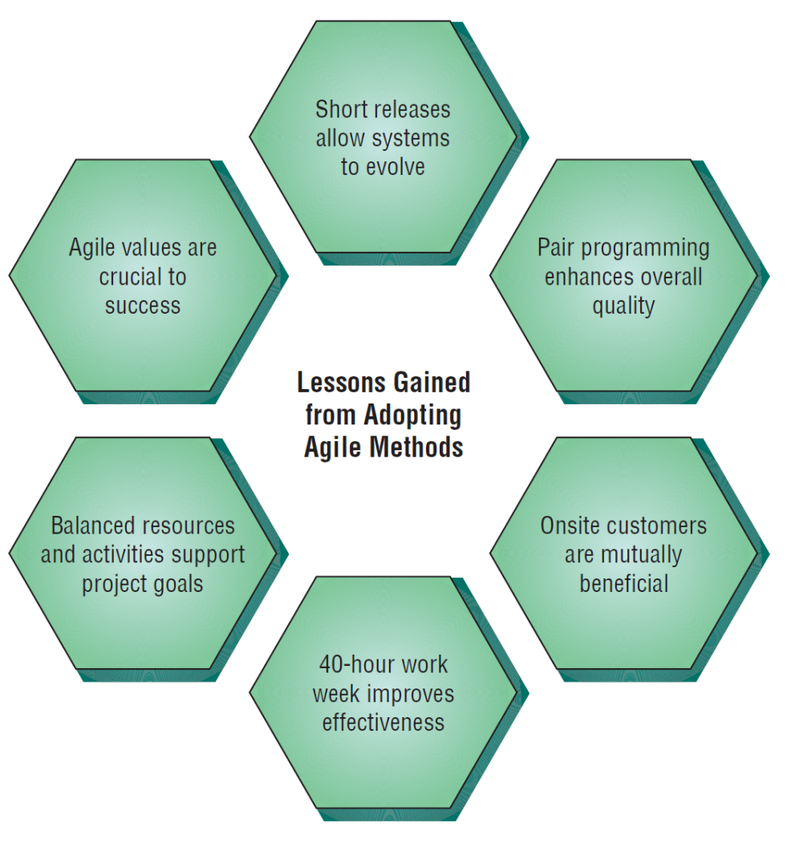
There Are Six Vital Lessons That Can Be Drawn from the Agile Approach to Systems (Figure 6.7)

Slide 45
Comparing Agile Modeling and Structured Methods
Improving the efficiency of systems development
Risks inherent in organizational innovation
Notes:
Efficiency—seven strategies that can improve the efficiency of knowledge work.
Risks—when is the appropriate time to upgrade human skills, adopt new organizational processes, and institute internal change.

Slide 46
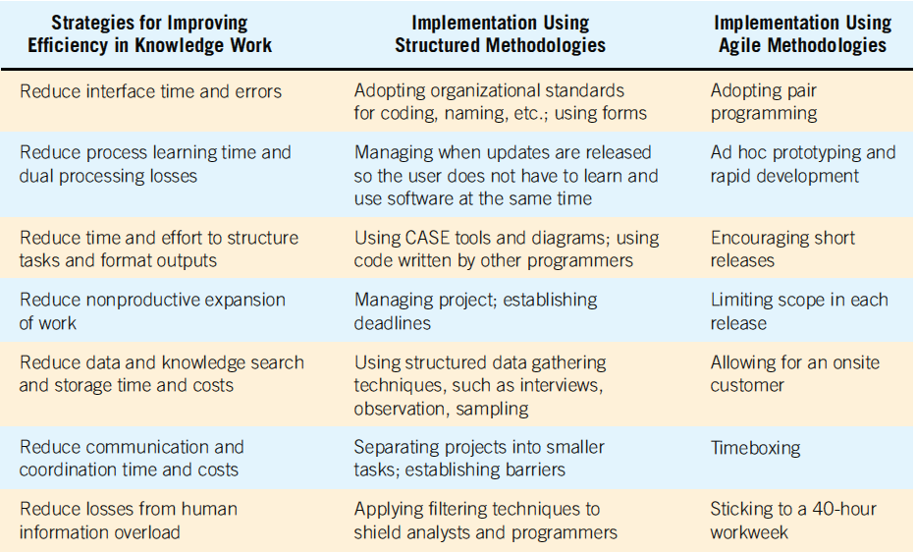
Strategies for Improving Efficiency Can Be Implemented Using Two Different Development Approaches (Figure 6.8)

Slide 47
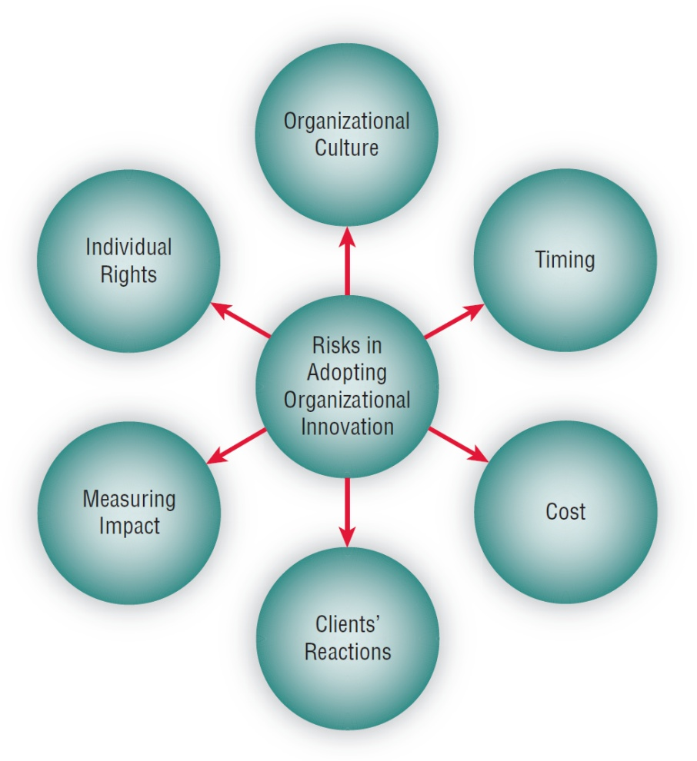
Adopting New Information Systems Involves Balancing Several Risks (Figure 6.9)
Notes:
In consultation with users, analysts must consider the risks that organizations face when adopting new methodologies.
Shows many of the variables that need to be considered when assessing the risk of adopting organizational innovation.

Slide 48
Risks When Adopting New Information Systems
Fit of development team culture
Best time to innovate
Training cost for analysts and programmers
Client’s reaction to new methodology
Impact of agile methodologies
Programmers/analysts individual rights

Slide 49
Summary
Prototyping
Patched-up system
Nonoperational
First-of-a-series
Selected-features
Prototype development guidelines
Prototype disadvantages

Slide 50
Summary (continued)
Prototype advantages
Users’ role in prototyping
Agile modeling
Five values of the agile approach
Principles of agile development
Agile activities
Agile resources

Slide 51
Summary (continued)
Core practices of the agile approach
Stages in the agile development process
User stories
Agile lessons
Scrum methodology
Dangers to adopting innovative approaches

Slide 52
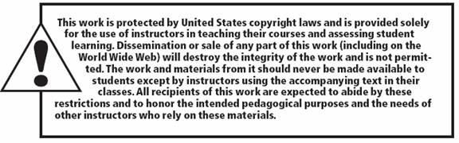
Copyright © 2014 Pearson Education, Inc.
Publishing as Prentice Hall

